Slide 1
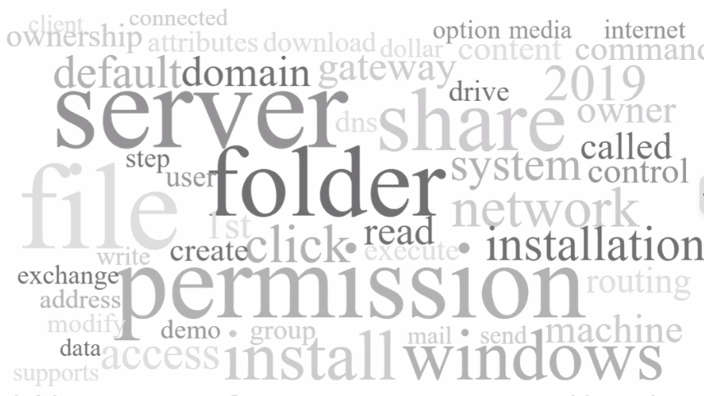
Windows – HyperVisor Platform

Slide 2

Installation Demo
“On Windows Server 2019 Lets Install
HyperVisor or Hyper-V
Virtualization Platform”

Slide 3
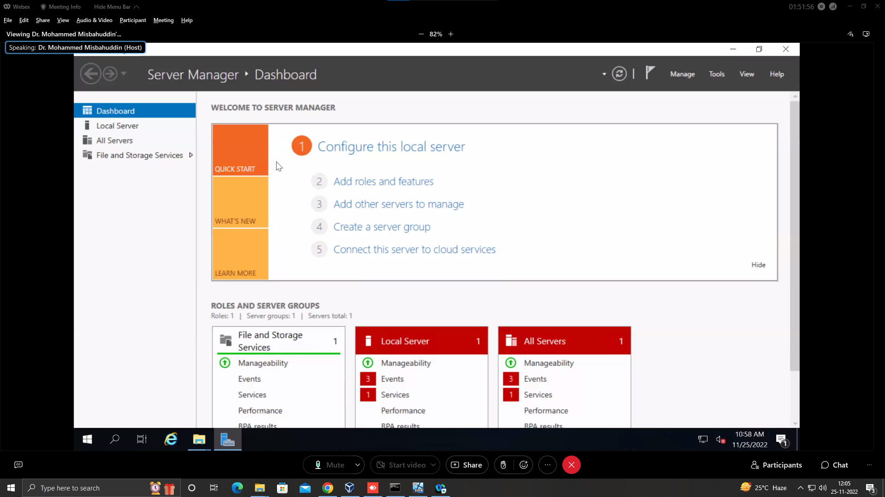
Step 1
Open Server Manager

Slide 4
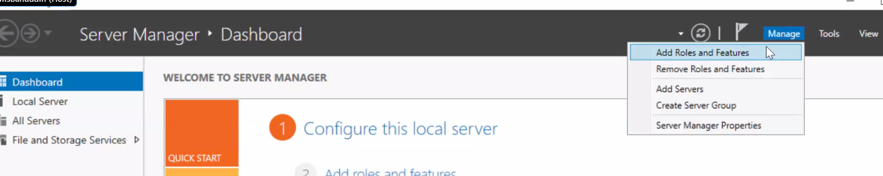
Step 2
Click on Manage then Add Role and Feature

Slide 5
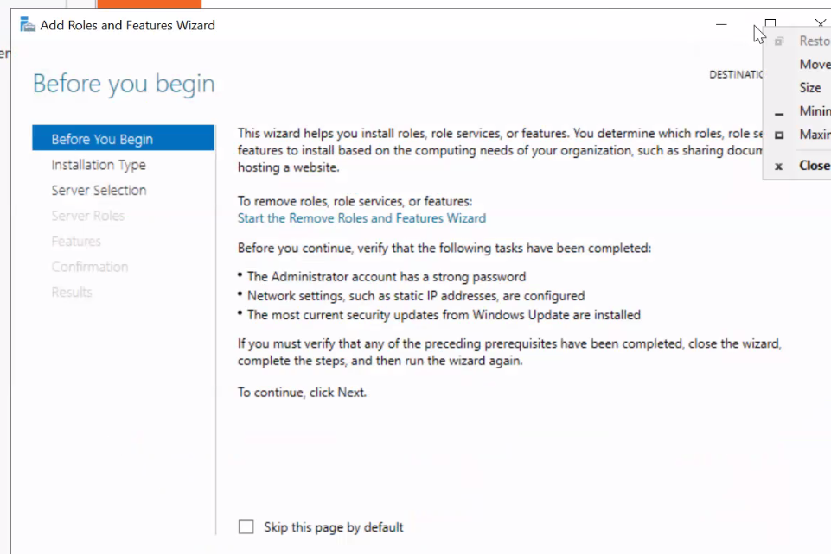
Step 3
Before you begin the Installation Verify the highlighted task
is Completed

Slide 6
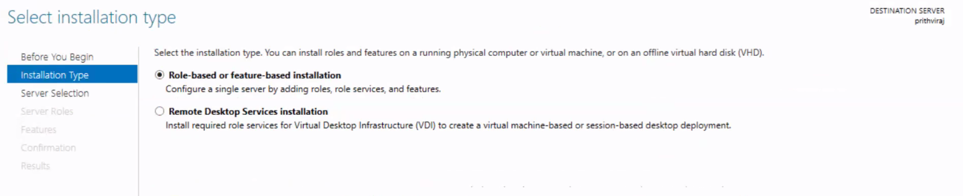
Step 4
Select Installation Type

Slide 7
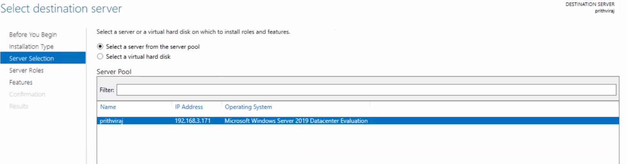
Step 5
Select Destination Server

Slide 8
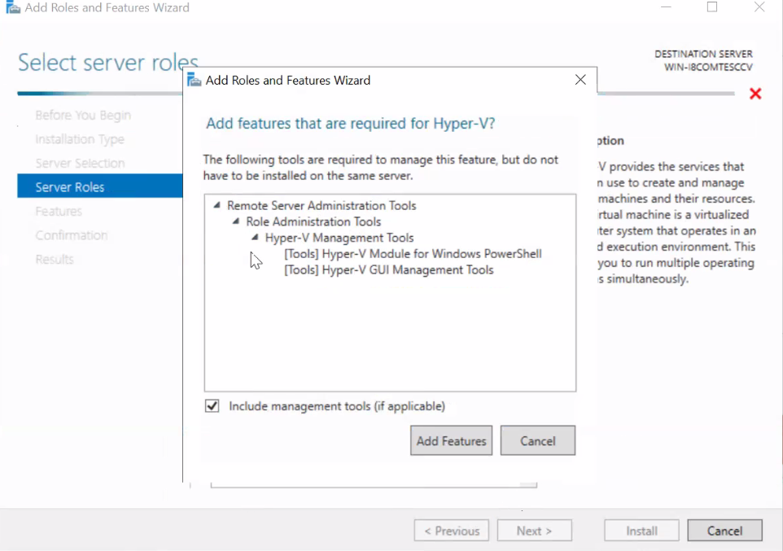
Step 6
Select Server Role As Hyper-V

Slide 9
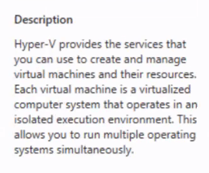
Description of Hyper-V

Slide 10
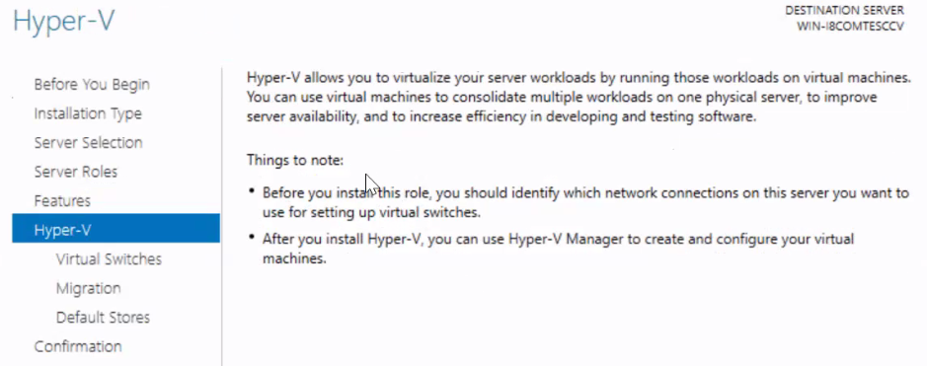
Things to Note

Slide 11
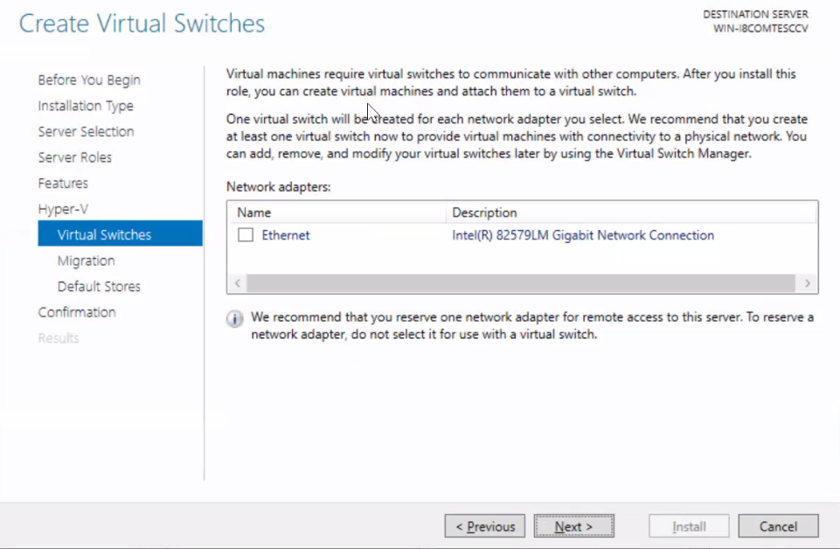
Create Virtual Switch

Slide 12
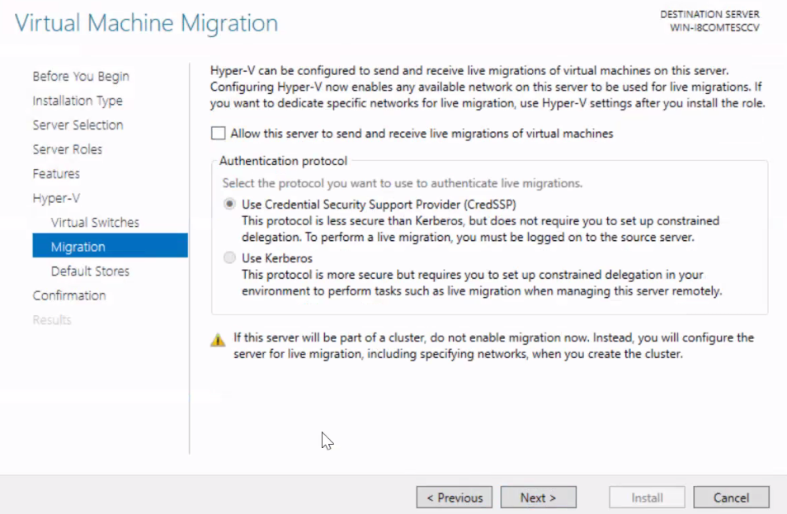
Virtual Machine Migration

Slide 13
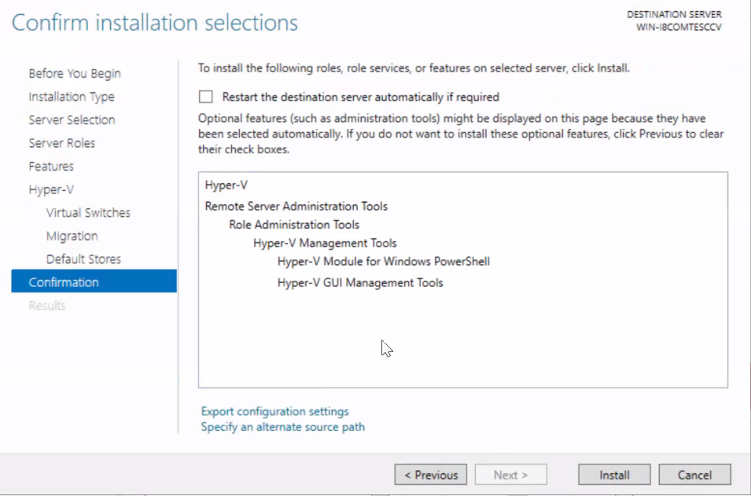
Step 7
Confirm the Installation of Hyper-V

Slide 14
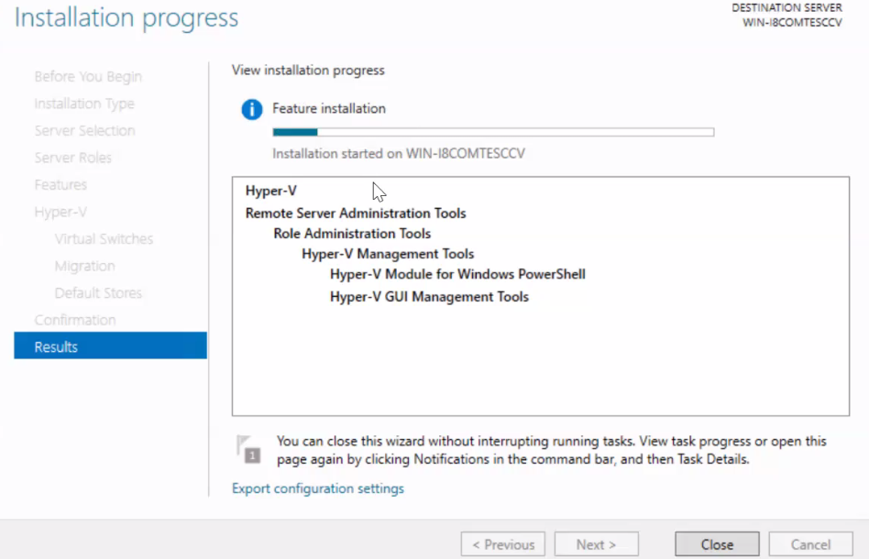
Installation Of Hyper-V will Begin

Slide 15
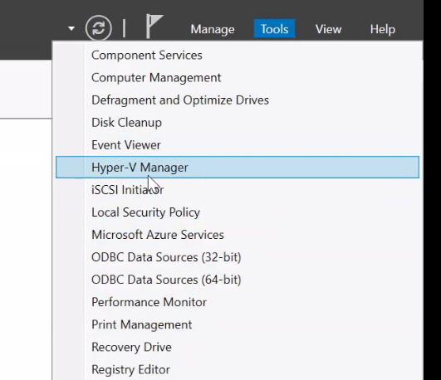
After The Installation of Hyper-V completes
Go To Server Manager again And Click On Tools then Hyper-V

Slide 16
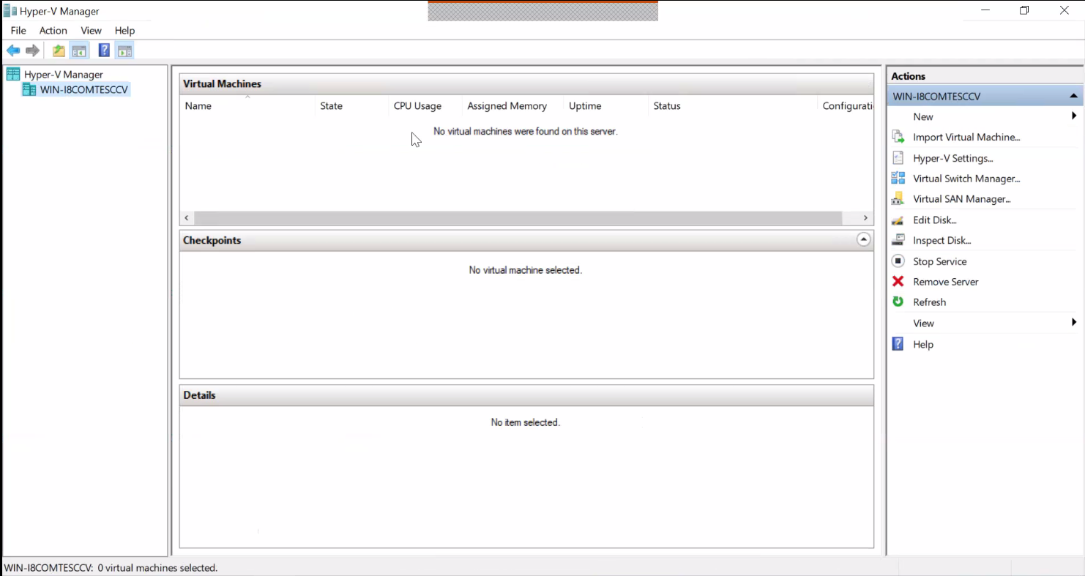
Hyper-V manager Will Open this is how it Looks

Slide 17
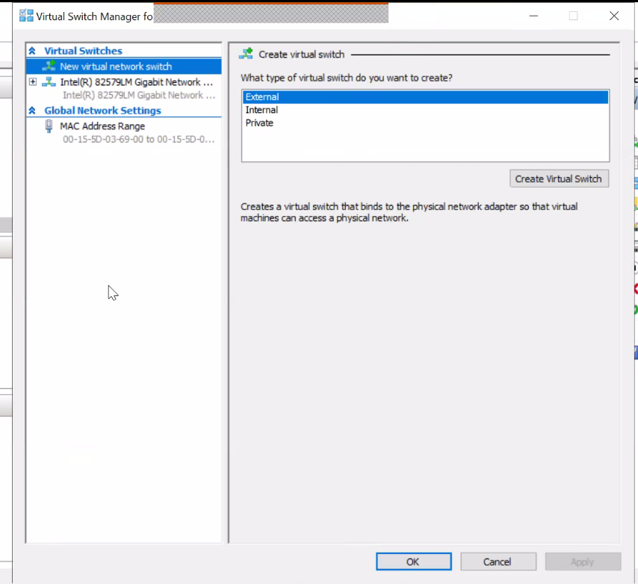
You Can Create Different Kind of Virtual Switches

Slide 18
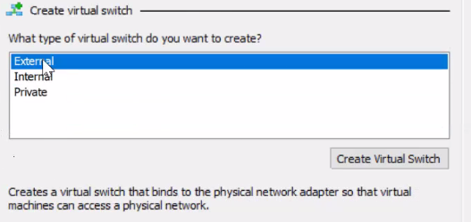
Types Of Virtual Switches

Slide 19
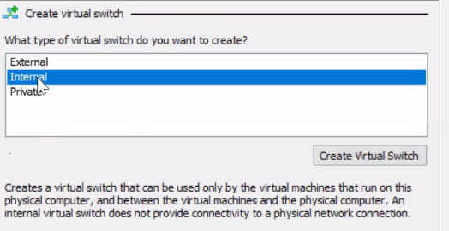
Like For Demo We will Create a Internal
Virtual Switch

Slide 20
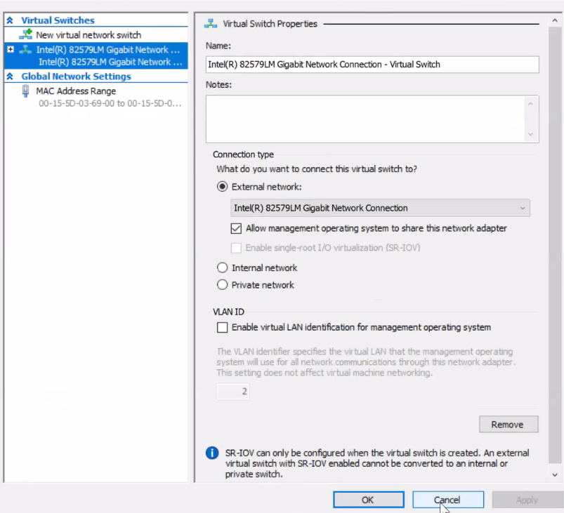
Properties of The Created Switch

Slide 21
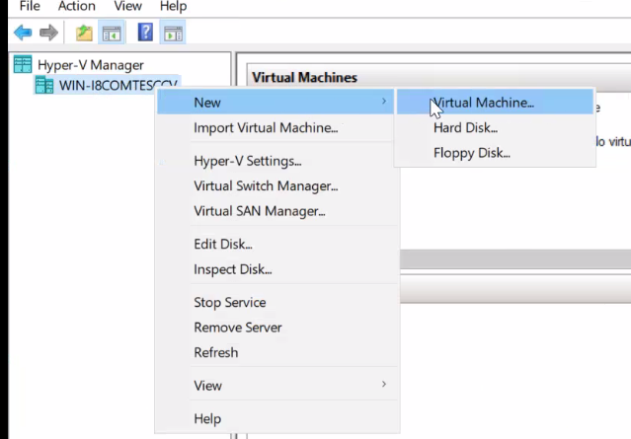
Let’s Create a New Virtual Machine Through Hyper-V
Go to Main Window of Hyper-V Right Click on our Server
Listed, Click New and then Virtual Machine

Slide 22
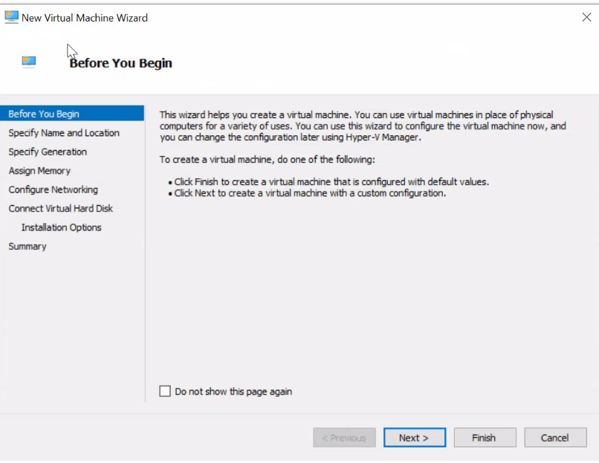
New Virtual Machine Wizard Will Open
Click Next >

Slide 23
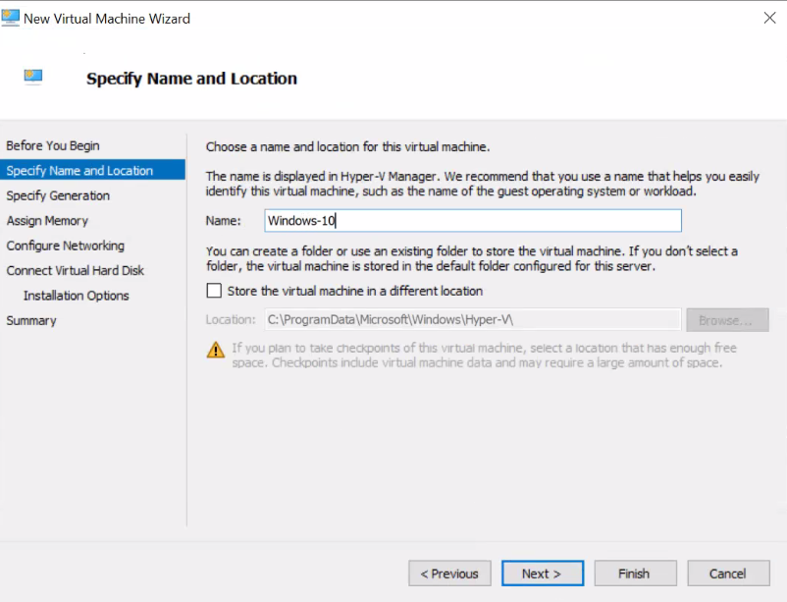
You Specify the Name And Location, In Our
Case we will Install Windows 10, Click Next >

Slide 24
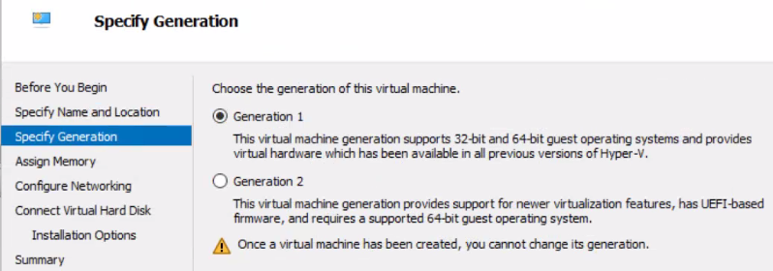
Specify the Generation,
Read the warning

Slide 25
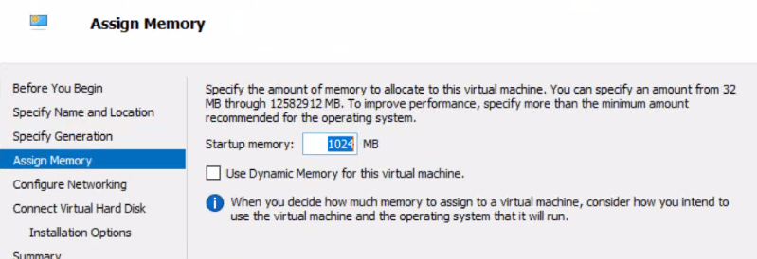
Specify the Amount Of Memory

Slide 26
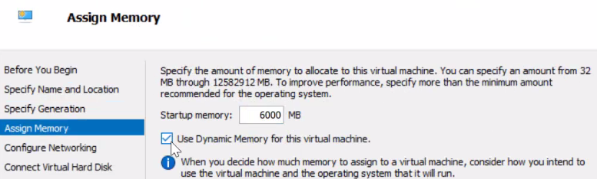
In our Case we are assigning 6GB of Memory

Slide 27
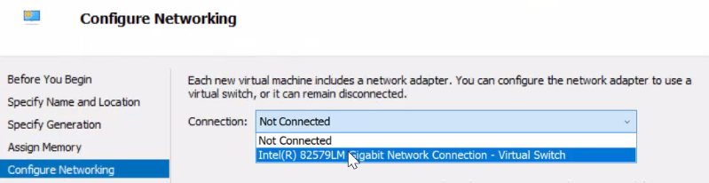
Configure Network

Slide 28
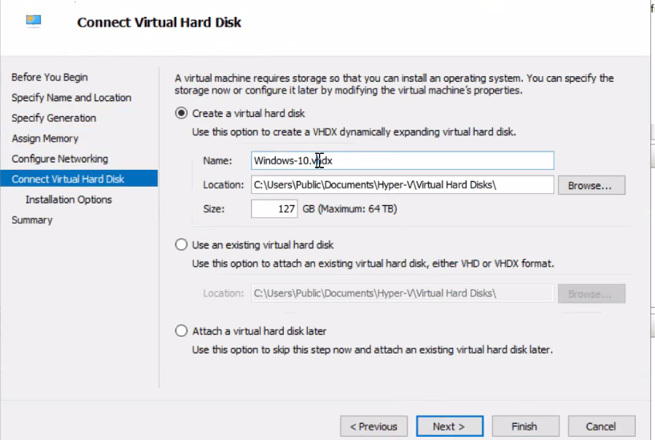
Connect a Virtual Hard Drive

Slide 29
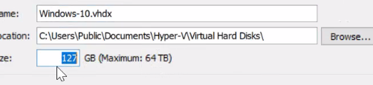
The Format of Virtual Hard Drive,
“vhdx” Format

Slide 30
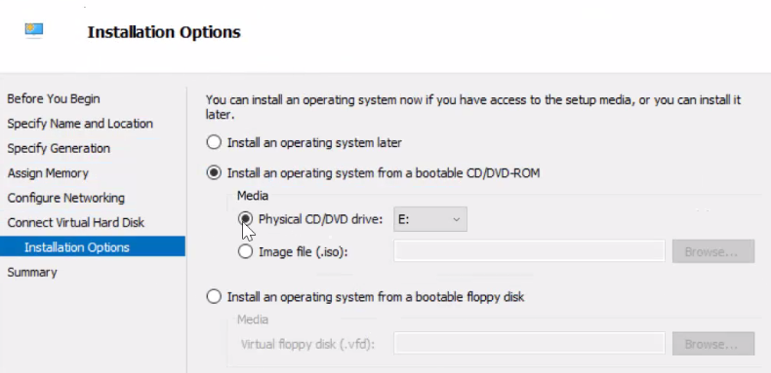
In Installation Option Select ISO File

Slide 31
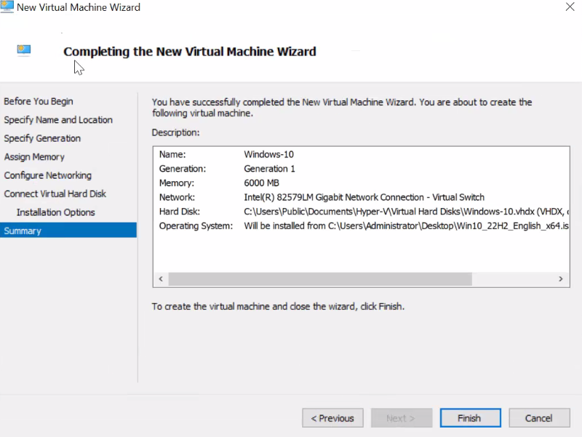
New Virtual Machine has Succesfully
Created, Click Finish

Slide 32
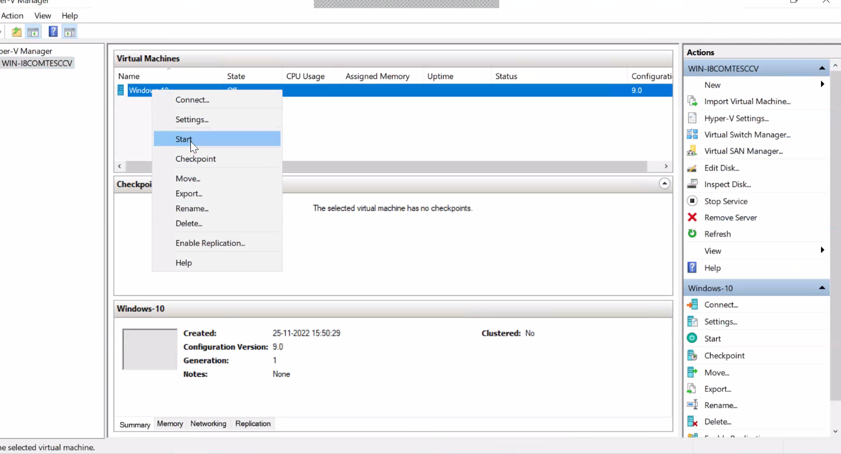
Go to main Window of Hyper-V Right Click on
on the New Virtual Machine and Click Start >

Slide 33
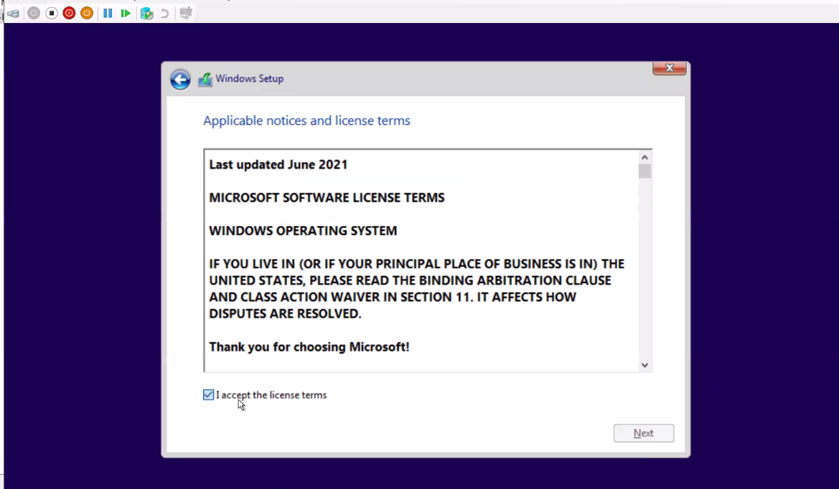
After that Installation the OS will Start follow all the Steps,
Like Accept Licence etc…

Slide 34
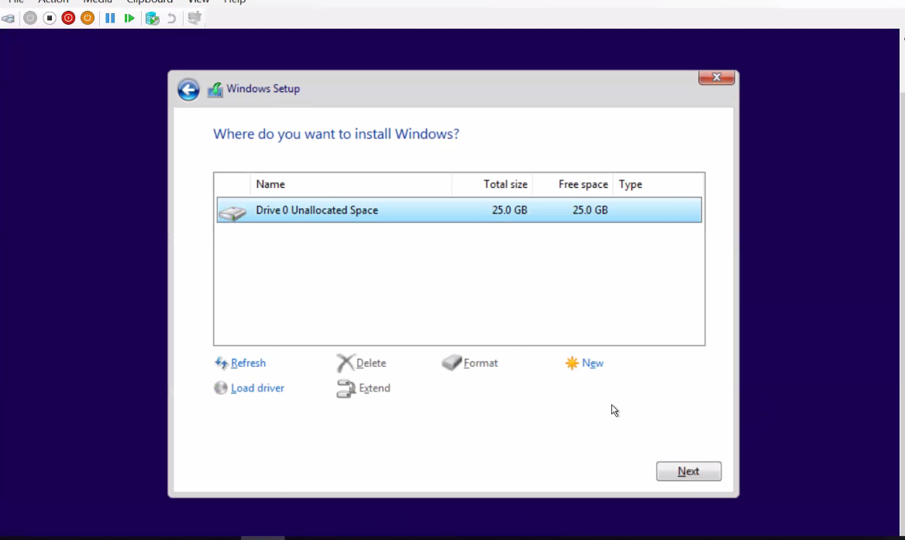
Allocate Memory to the OS

Slide 35
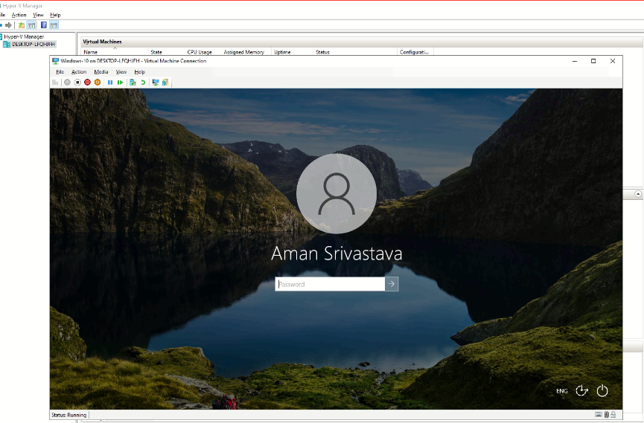
After Following the process Windows 10 Will be
Successfully Installed and Ready To Use

Slide 36
Thank You!
Dr. Sanjay Adiwal
Joint Director
Centre for Development of Advanced Computing (C-DAC)
Bangalore

